Slide 1
Statistical Process Control
A Lesson in Quality Management
Aaron Clare, Anthony Juritsch, and Faith Rasmussen

Slide 2
Overview
Introduction
Establishing a Statistical Process Control
Functional Uses of Statistical Process Control
Summary

Slide 3
Introduction

Slide 4
Why have in-line statistical Process Control?
Expedient determination of deviations
Cost Saving Procedure
Provides in depth knowledge of the process

Slide 5
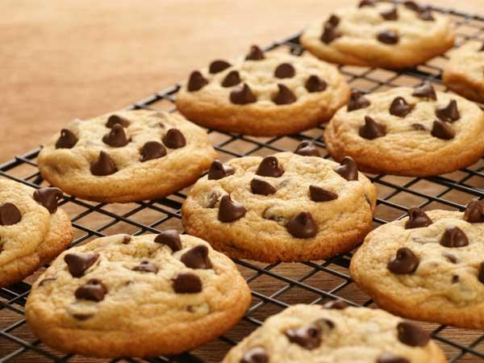
Example Cases of Statistical Process Control in an Industrial Setting
A Cookie Conundrum

Slide 6
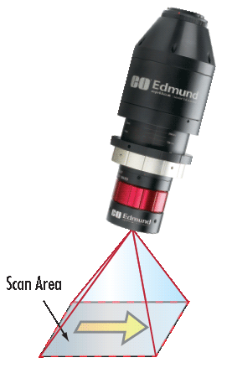
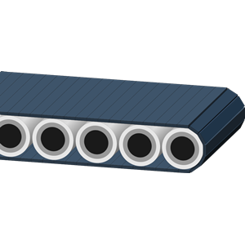
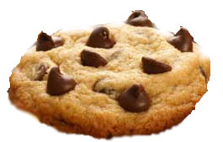
Example Cases of Statistical Process Control in an Industrial Setting
Expected Chocolate chip coverage coverage: 25% (Assuming equal distribution)
Expected Deviation in chocolate chip coverage: 2%

Slide 7
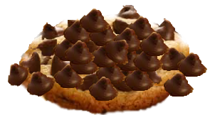
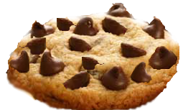
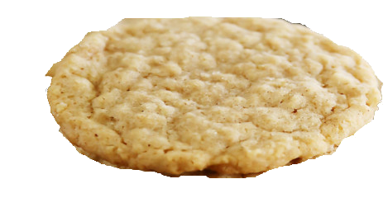
Example Cases of Statistical Process Control in an Industrial Setting
How do you tell when the process is in control?

Slide 8
Establishing A statistical Process Control

Slide 9


Required Components
A process, or a process step.
Data from the process
Continuous data collection method
An average (baseline) value,
The Standard Deviation,

Slide 10
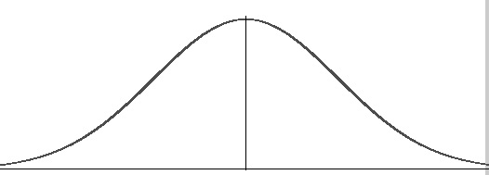
Constructing a Process Control Chart
-3σ
+3σ

Slide 11


= 25%
σ = 2%
+/-3σ = 19-31%

Slide 12
= 25%
σ = 2%
+/-3σ = 19-31%
19%
25%
31+

Slide 13
Process Control Chart
31+
31+
25%
25%
19%
19%

Slide 14
Process Control Chart
31+
X
X
X
X
X
25%
X
19%
X

Slide 15
Interpreting a Variation
Special Variation - Uncontrollable factors lead to variation in process
May be minor or serious
Need not adjust process
Common Cause Variation
“Expected” Variation
Reason for Monitoring our system
Review Process and need for maintenance (expensive) or change in process capability (free)

Slide 16
Process Capability and
Customer Specifications

Slide 17







Process capability ‘Cp’

Slide 18
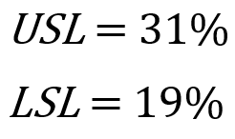
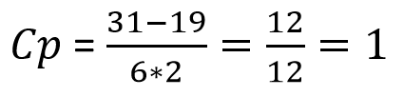
Process capability ‘Cp’
19%
31%
At least 99.7% of cookies produced will be within limits!

Slide 19
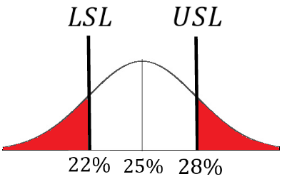
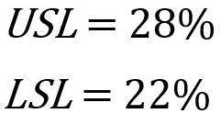


Process capability ‘Cp’
Too many cookies produced will be outside the limits.

Slide 20
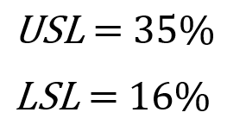



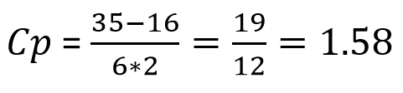
Process capability ‘Cp’
More than 99.7% of cookies produced will be within limits!

Slide 21
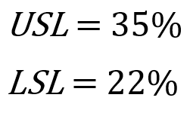

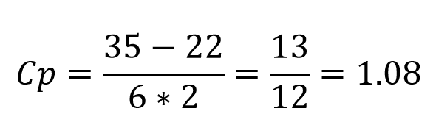
Process capability ‘Cpk’
Are we good?

Slide 22
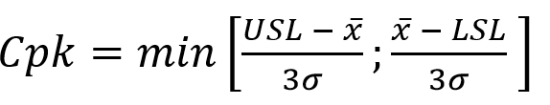
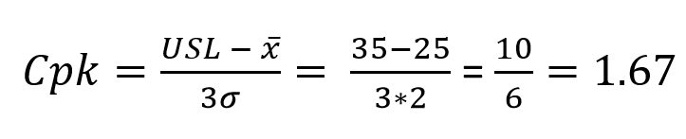
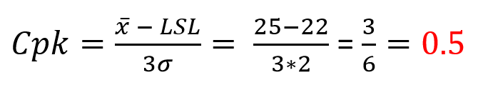

Process capability ‘Cpk’
Too many cookies produced will be outside the limits.

Slide 23
Summary:
Statistical Process control is beneficial for establishing process capability and determining when a process is functioning within set limits.
To establish a Statistical Process Control you need:
A process, or processing step
Continuous data from the processing step
A Baseline,
A standard deviation,
99.7% of the units in the process should fall within ±3σ of the mean.
To set customer specification limits, a producer should consider the process capability.

Slide 24
Sources
Complexity Made Simple - Why Statistical Process Control (SPC) https://www.youtube.com/watch?v=KnY8Syl6I3A
Introduction to Quality Control – Statistics Chapter, Section 4 https://www.youtube.com/watch?v=_RXfZtBPOhc
Cpk explained by Professor Cleary https://www.youtube.com/watch?v=ewHGNNzKjdU&t=264s
Video on CP Cpk from Advance Innovation Group https://www.youtube.com/watch?v=0ohQF6j9fJo&t=3s
Process capability index https://en.wikipedia.org/wiki/Process_capability_index

Slide 25
Questions?

